Slide 1
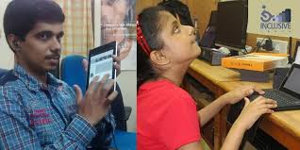
Mobile Application for the blind student
Name:-Patel Marvin V.
PID No.:-770
Batch:-11
ER No.:-CBA11
Branch:-CBA

Slide 2


Currently picking up a smartphone and start using it without assistance is a difﬁcult task with little to no native support. of ﬂicking or dragging their ﬁnger through) the screen until they eventually found the option they were looking for.
What is challenge to use application for blind students ?

Slide 3
Provided By My Application
Connect to writer
Sports news
In this application
Help for students

Slide 4
Availability For Student
Writer
Completion
Availability
Details

Slide 5
A writer also do
Tongueless
Blind
Hearing-impaired

